Slide 1
Variables
Notes:
Purpose:
To introduce the use of variables.
Learning objective:
By the end of this tutorial, children should be able to:
Understand that variables can be used to store and manipulate values.
Write simple programs that use variables to count things.
Write simple programs that use values stored in variables to alter their behaviour.

Slide 2
Variable
Notes:
Introduce students to key vocabulary for this lesson:
Variable: A variable is a simple way of storing one piece of information somewhere in the computer’s memory whilst a program is running, and of getting that information back later.

Slide 3
A variable stores a piece of information in a computer’s memory while a program is running, that can be retrieved when needed.
Notes:
Explain the concept of a variable.
A variable stores a piece of information in a computer’s memory while a program is running, that can be retrieved when needed.
A variable is an example of a data structure. As pupils move on to Secondary school, they will learn about other data structures such as arrays.
A variable can be a number or text or perhaps true/false.
Programs can store, retrieve or change the values of variables. Variables are an abstraction of data storage and retrieval: as programmers, we need not know how exactly the programming language, operating system and hardware manage and handle them.

Slide 4
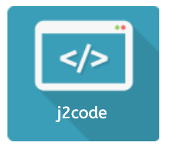
Notes:
Purpose To introduce the use of loops in j2e code visual
Learning Objectives
To use variables in the context of a game.
To analyse and explain how an existing program works.
Learning Outcomes
All children: will change how a variable works in the planet game
Most children: will use a new variable in the planet game.
Some children: will create their own game using multiple variables.
Resources
Template: j2e.com/code/template/Y5Template3
Example: j2e.com/code/examples/Visual/Y5Example3
Video: just2easy.com/vids/j2code/Y5Video3

Slide 5
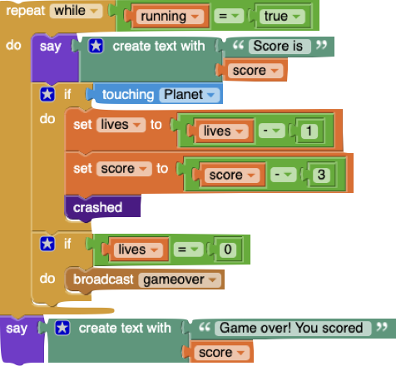
Notes:
Ask your students to trace this code (read through it) What can they see? Can they make a prediction on this code will do?
Are there any coding block they recognise from previous lessons/are they any new blocks?

Slide 6
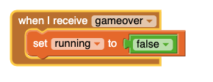
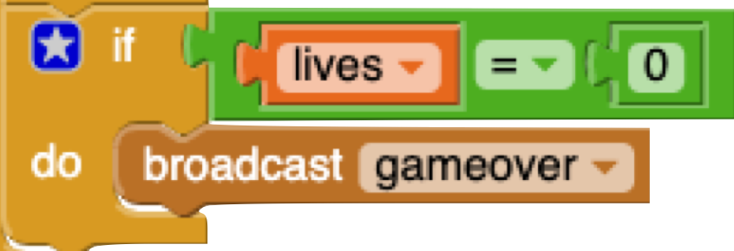
Notes:
Ask them to explore the broadcast block can they see the link with another block?
The broadcast (_) block is an event block and a stack block which sends a broadcast throughout the whole Scratch program. Any scripts with any sprites that are “hatted” with the When I Receive (_) block that is set to a specified broadcast will activate.
Broadcasts are a good way to have sprites and scripts communicate.

Slide 7
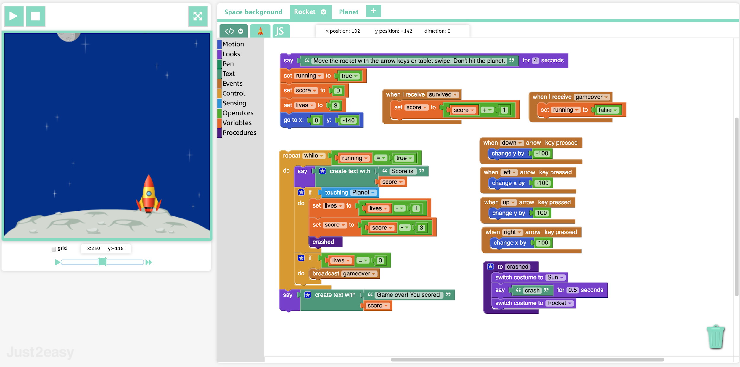
Notes:
Show the example https://www.j2e.com/code/examples/visual/Y5Example3?edit
Note that the game ends when the planet has dropped 10 times, or when there have been 3 crashes. Children analyse how the code is working and share ideas.
Draw attention to the variables "score" and "lives".
Explain that sprites communicate with each other using the "broadcast" block.
Main Activities
Load the template. This is a simple version of the game without the "lives" variable and it does not decrease the score when the rocket crashes.
Task 1. Add in code to decrease the score by 3 when the rocket crashes. (Use the "set score to" block).
Task 2. Add in a "lives" variable so that the game ends after 3 crashes. (They will need to broadcast "game over" when lives is equal to 0).

Slide 8
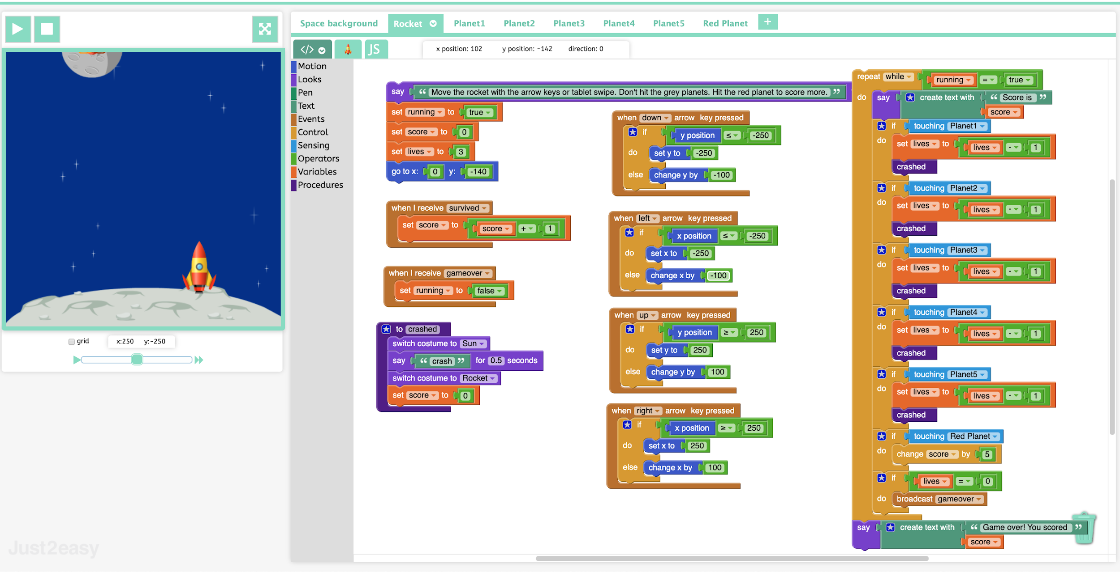
Notes:
Challenge
Children can "clone" the planet sprite and change it to a different planet. They can then experiment with the code so the object of the game is to hit the new planet. Look at the example "planet strike" and try making various changes to it.
Share the games with younger children in the school. Those with access to the just2easy Toolsuite may do that with blogging or sharing, other schools may use the "link" button.

